Slide 1

CMPE 152
Mini Python Compiler
Van Duong
Hoang Nhat Ho

Slide 2
Introduction
Implement a small compiler for a subset of Python with arithmetic expression, if/else statements, while loop, and print statement
Translate source programs into assembly language programs
Execute the generated assembly with our tiny virtual machine
Implementation with theory: regular expressions, DFA, CFG, CNF, GNF, and error handling

Slide 3
Phases
Perform lexical analysis to convert characters into a stream of tokens using regular expressions
read input character of source program
group into lexemes
produce a sequence of tokens
Parse the token stream with a parser
parse token generated from lexer
build an Abstract Syntax Tree (AST)
Generate assembly instructions from the AST
x86 assembly program will be generated

Slide 4
Lexical Analysis
Scans raw source code and breaks into tokens
Regular expression defines token pattern for:
Identifiers follow the pattern [A-Za-z_][A-Za-z0-9_]*
Numbers follow: [0-9]+
We match operators like ==, !=, <=, >=, <, >, +, -, *, and /
Whitespace and comments are recognized tokens that the lexer can skip while still tracking line numbers.
Accepted keyword: if, else, while, print
Error handling allowing continue parsing when detecting illegal character

Slide 5
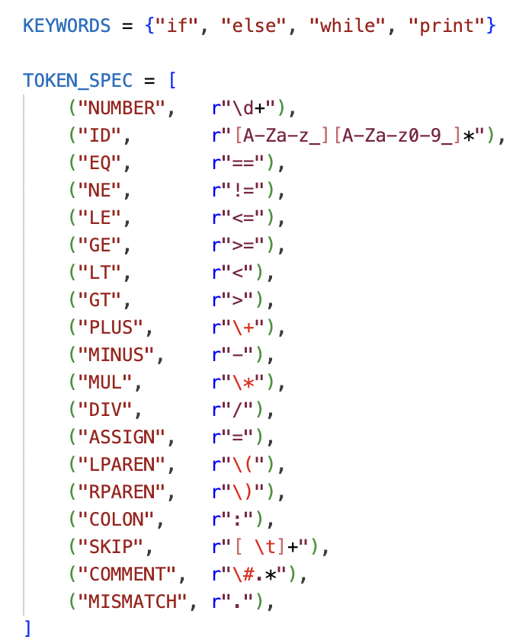
Regular Expressions
Store token rules in TOKEN_SPEC as (name, pattern) pairs for numbers, identifiers, operators, and punctuation.
Compile all patterns into a single MASTER_RE using named capturing groups for each token type.
This structure lets us extend the language easily by adding new entries to TOKEN_SPEC and KEYWORDS.

Slide 6
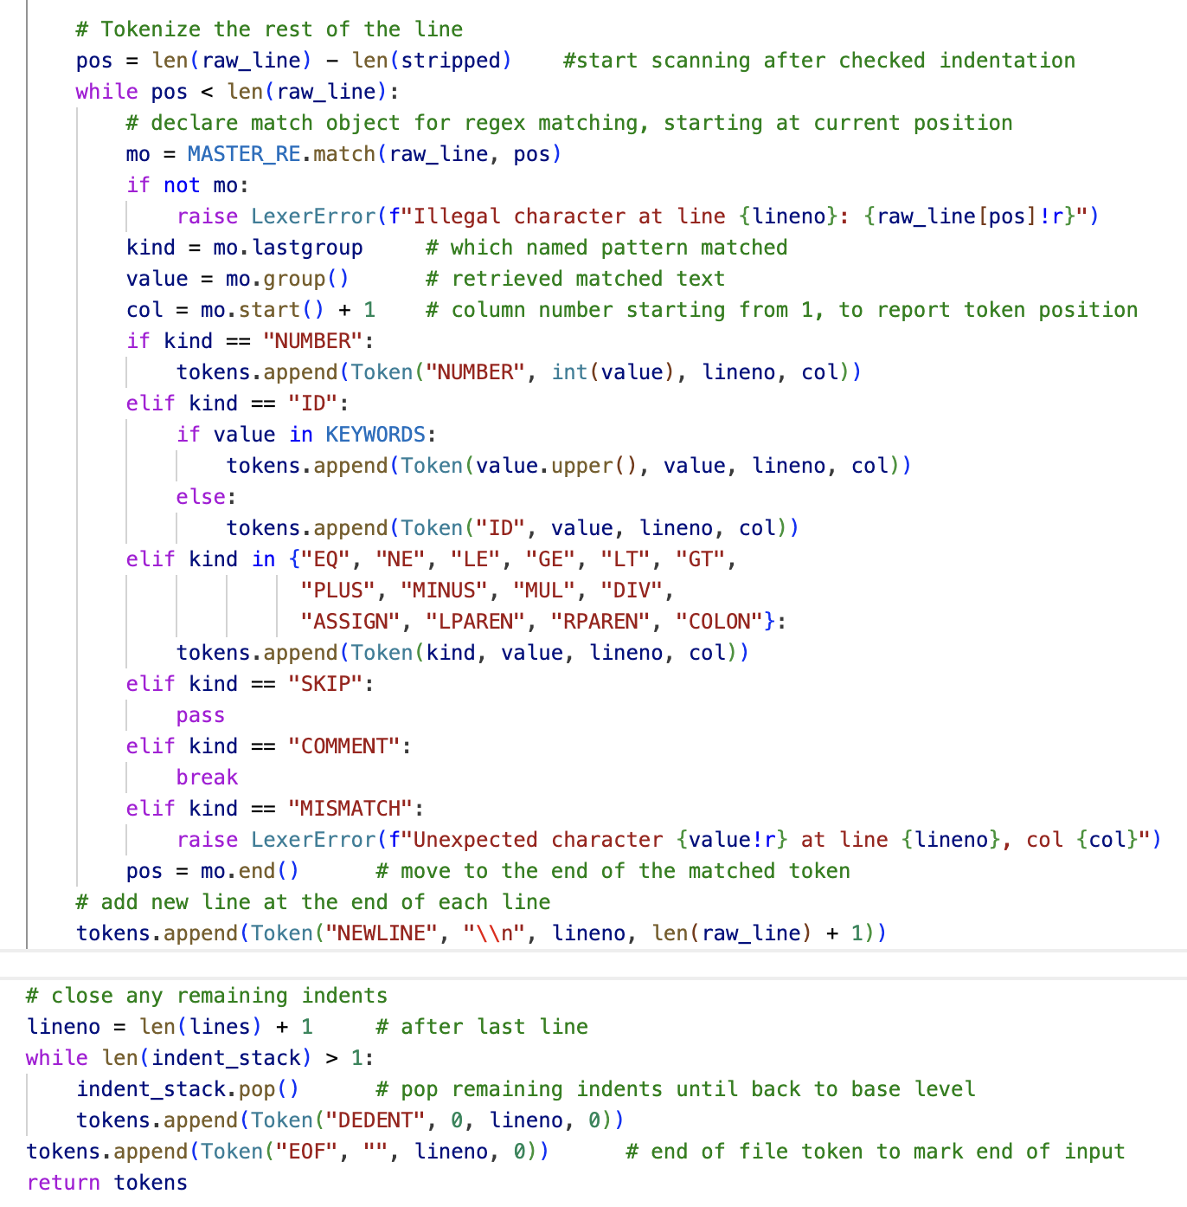
Lexeme Generation & Token Classification
Lexer scans input and produces lexemes.
Lexemes are then converted into tokens to be ready for syntax analysis
Identifiers such as ‘if'’, ‘else’, ‘while’, and ‘print’ are reclassified as keyword tokens.
Token EOF will be added at the end of the token stream

Slide 7
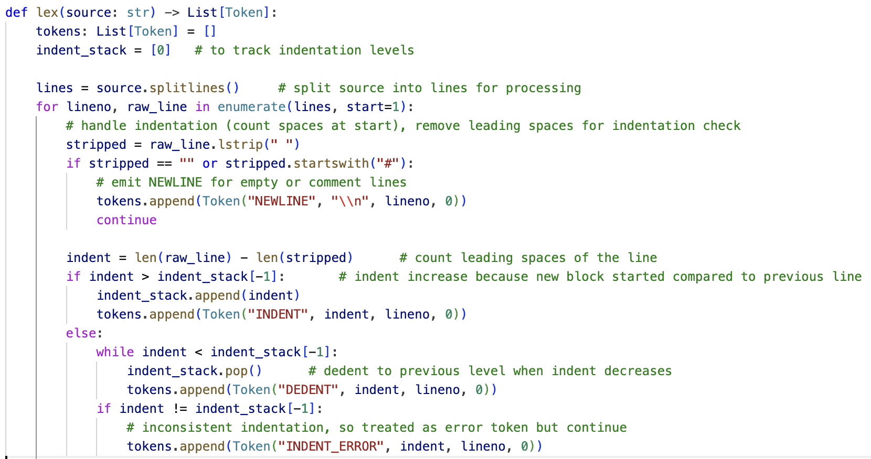
Indentation and Lexical Structure
Mimic Python style blocks by interpreting leading spaces on each line as indentation levels
Maintain an indent_stack and push or pop when indentation increases or decreases compared to previous lines
Emit INDENT and DEDENT tokens whenever the indentation level changes
Blank or comments still generate a NEWLINE token but do not affect indentation

Slide 8
Deterministic Finite Automaton (DFA)
Deterministic Finite Automaton (DFA) for recognizing ID and NUMBER tokens
q_init: start state. This is where lexical analysis begins by start scanning
q_id: identifier state, consuming letters, digits, or ‘_’ until a non-matching character ends the token
q_num: number construction state, consuming digits until we see a non-digit
q_err: trap state, which represents unexpected character sequence

Slide 9
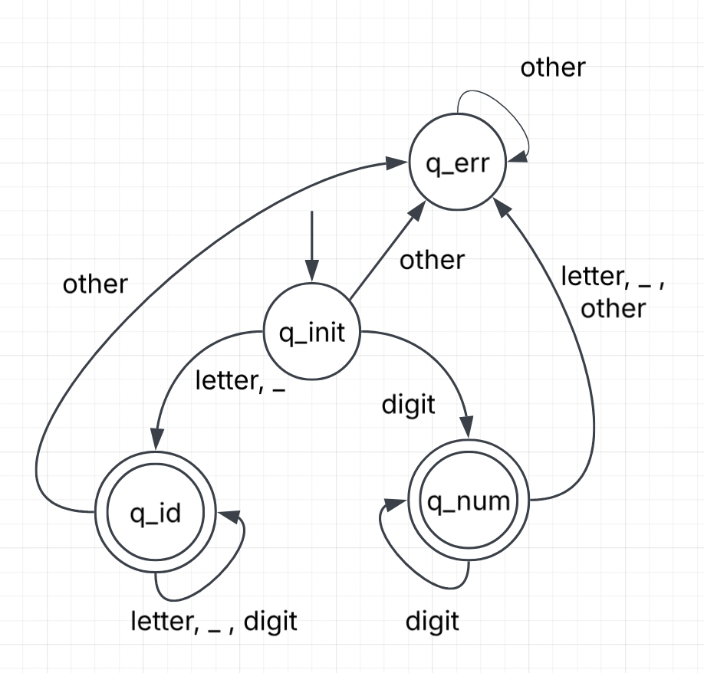
Deterministic Finite Automaton (DFA)
Transition table
 | input | next state
→q_init | letter, _ | q_id*
 | digit | q_num*
 | other | q_err
q_id* | etter, _ , digit | q_id*
q_id* | other | q_err
q_num* | digit | q_num*
q_num* | letter, _ , other | q_err
q_err | letter, _ , digit, other | q_err

Slide 10
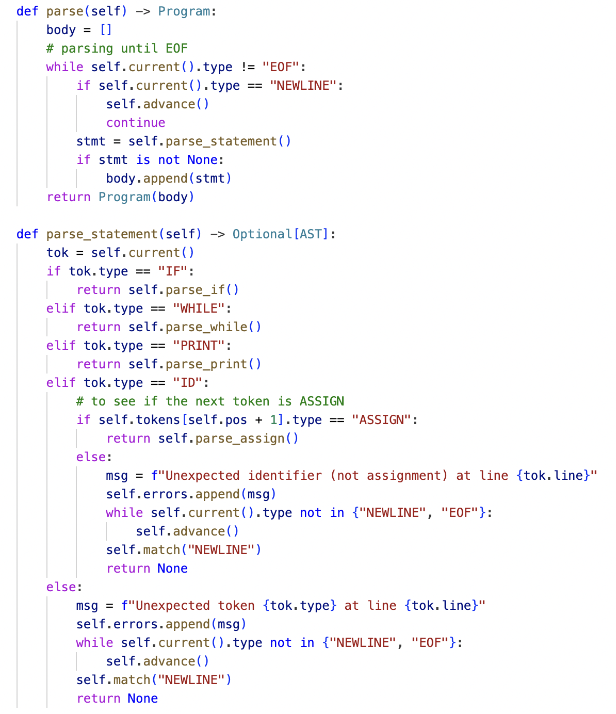
Parser
We implement a recursive descent parser that follows the grammar structure, reads tokens in order, consumes the token list, and builds an AST
The parse() method loops until reaching EOF in token list generated from the lexer, skipping NEWLINE tokens and repeatedly calling parse_statement().
The parser checks which kind of statement to parse based on the first token: IF, WHILE, PRINT, or ID for assignments.
Unexpected tokens are reported as errors, and the parser will skip to the next NEWLINE or EOF to keep parsing.

Slide 11
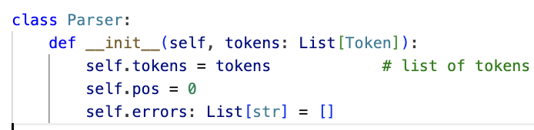
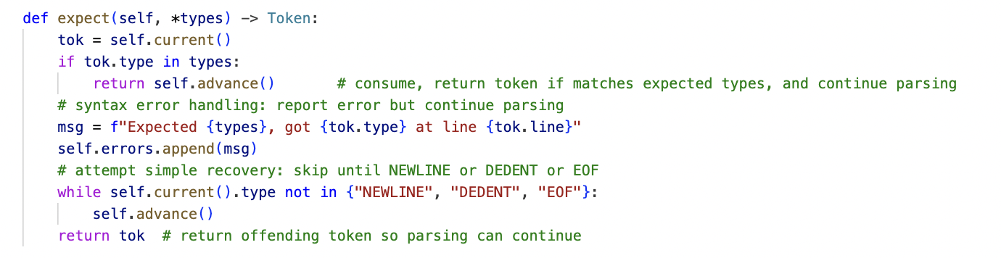
Error Handling
The Parser class stores all error messages in an internal errors list so we can display them together.
The expect() helper reports mismatched tokens, records the line number, and then performs recovery mode.
Recovery is implemented by continue parsing until sees NEWLINE, DEDENT, or EOF, which usually marks the end of a statement.
This approach lets us continue parsing subsequent statements and produce multiple error messages from a single run.

Slide 12
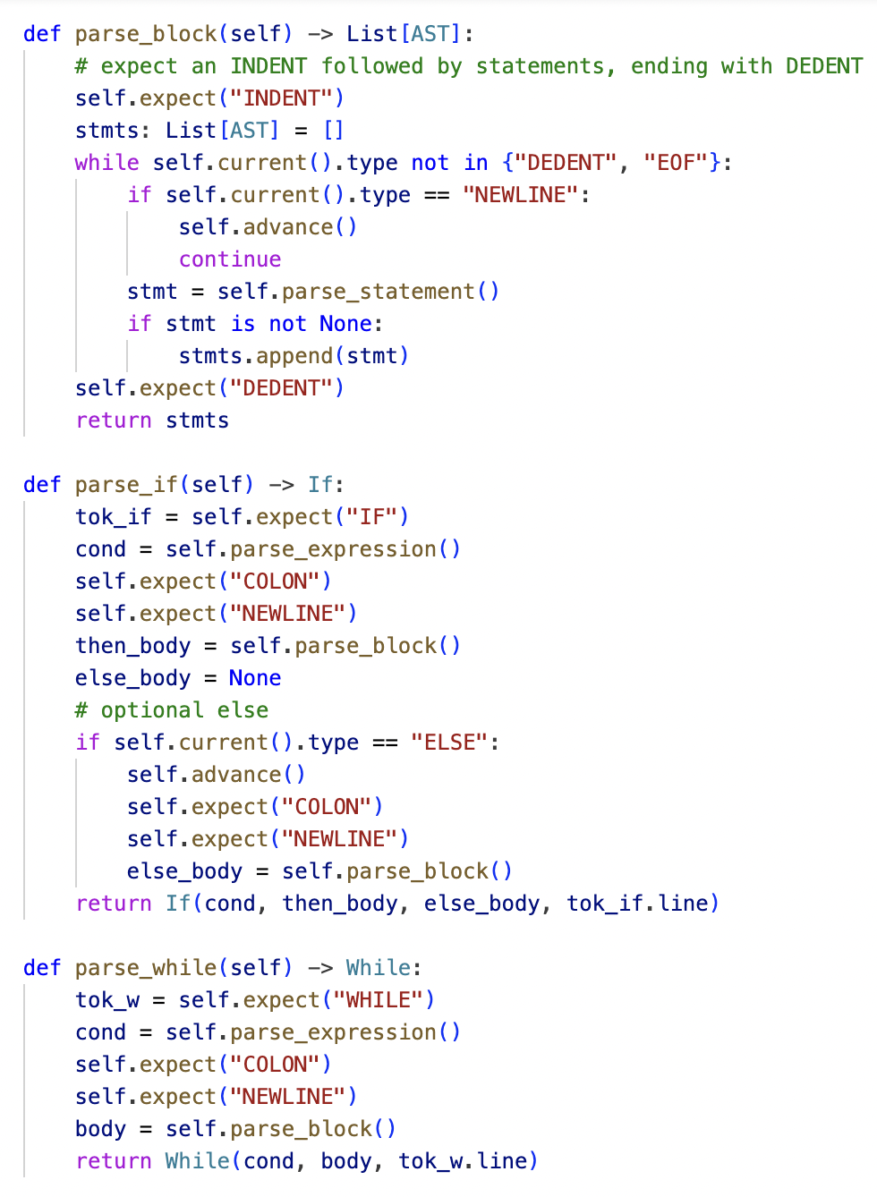
Block and Indent Handling in Parsing
As we include INDENT and DEDENT tokens for block structure in the lexer, the parser must also handle them using parse_block(), which expects an INDENT token at the start.
Inside a block, it repeatedly parses statements until see a DEDENT or EOF token, ignoring NEWLINE.
‘If’ statements call parse_block() to read the ‘then’ body and parse ‘else’ block if there is one
‘While’ statements also call parse_block() so that the entire loop body is grouped in the AST.

Slide 13
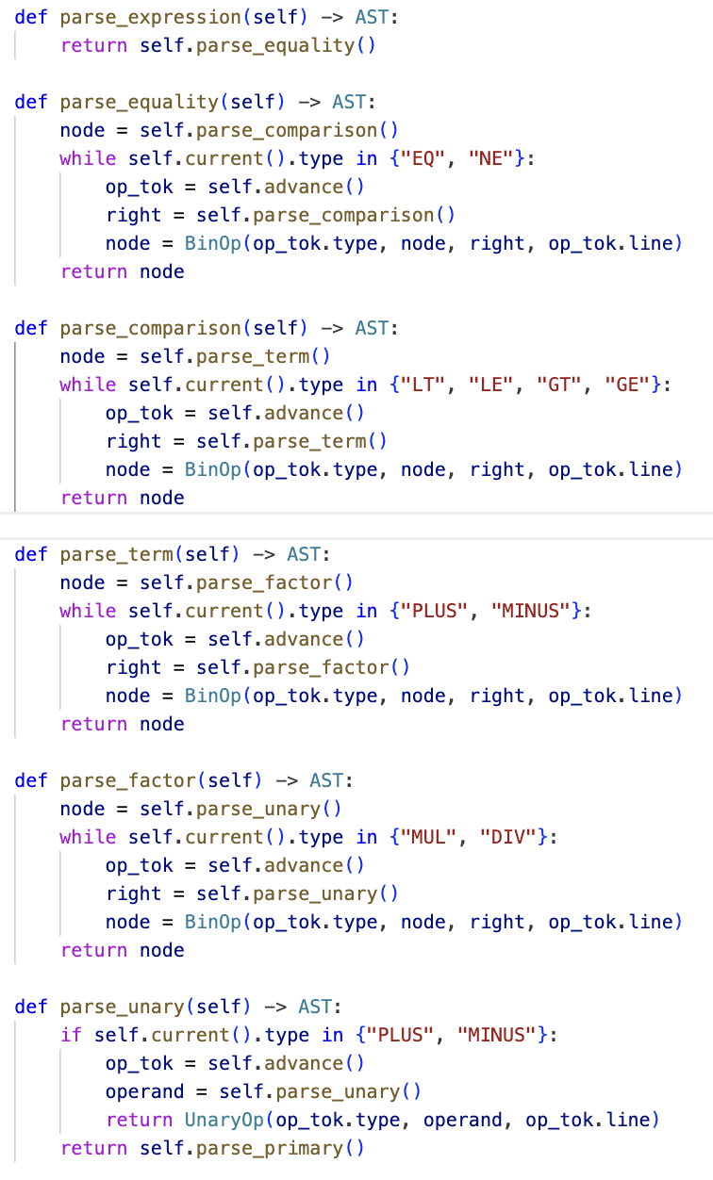
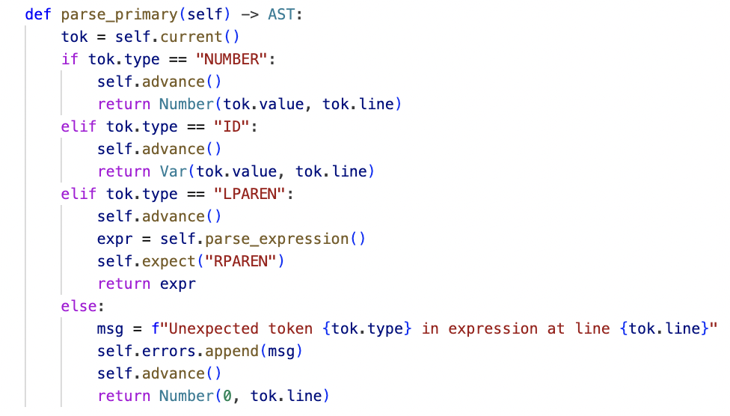
Expression Parsing (Precedence)
We parse expressions step by step, from statement down to variable: equality → comparison → term → factor → unary → primary.
parse_equality() will check EQ and NE operators.
parse_comparison(), parse_term(), and parse_factor handle relational and arithmetic operators
parse_unary() processes leading PLUS or MINUS, and parse_primary() recognizes numbers, variables, and parenthesized expressions.

Slide 14
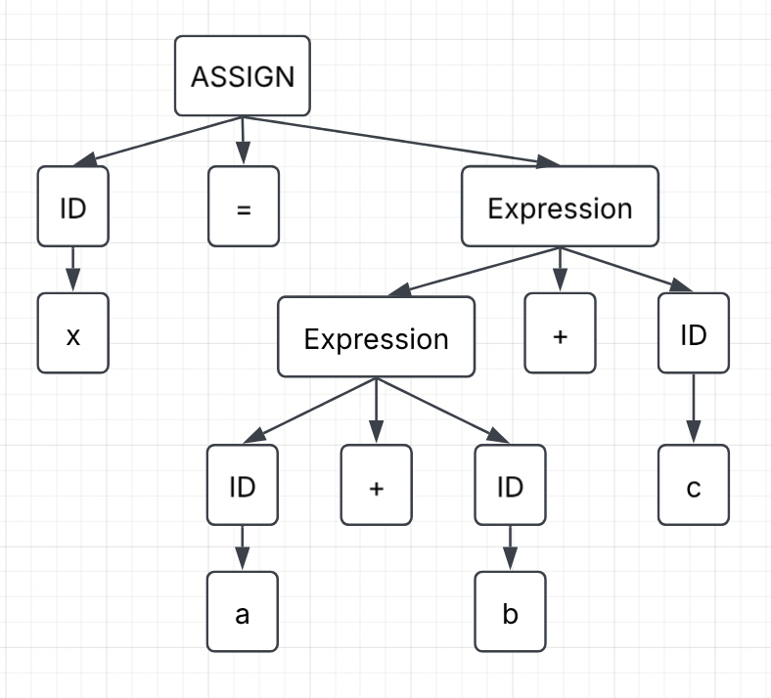
Left/Right Derivation
Each function in parse_expression() starts by parsing on left hand side first, then check to see if next token is the operator of that level. The parser then parses the right hand side.
Good tree for example, x = a + b + c

Slide 15
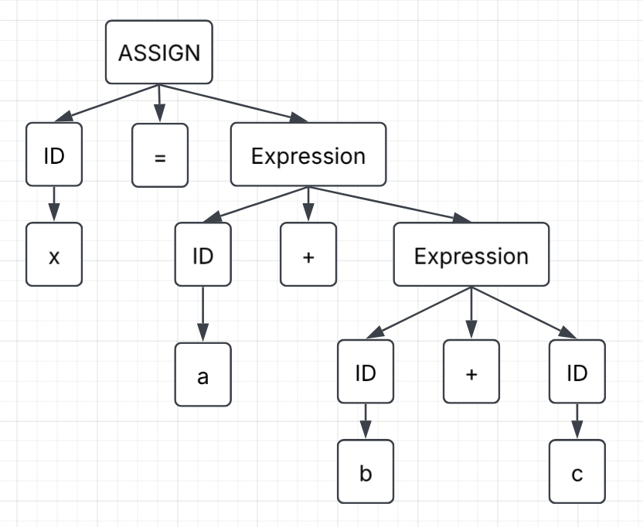
Left/Right Derivation
Bad tree for example, x = a + b + c

Slide 16
Context-Free Grammar (CFG)
From the parser’s behavior, construct a CFG captures the grammar the parser recognizes, using BNF notation
Program → StmtList
StmtList → Stmt StmtList | Newline StmtList | ε
Stmt → IfStmt | WhileStmt | AssignStmt | PrintStmt
IfStmt → if Expr colon newline Block ElseStmt
ElseStmt → else colon newline Block | ε
WhileStmt → while Expr colon newline Block
AssignStmt → id assign Expr
PrintStmt → print lparen Expr rparen
Block → indent StmtList dedent
Expr → Equality
Equality → Compare Equality_tail
Equality_tail → (eq | ne) Compare Equality_tail | ε
Compare → Term Compare_tail
Compare_tail → (lt | le | gt | ge) Term Compare_tail | ε
Term → Factor Term_tail
Term_tail → (plus | minus) Factor Term_tail | ε
Factor → Unary Factor_tail
Factor_tail → (mul | div) Unary Factor_tail | ε
Unary → (plus | minus) Unary | Primary
Primary → num | id | lparen Expr rparen

Slide 17
Chomsky Normal Form (CNF)
An example that shows how part of our grammar can be rewritten in Chomsky Normal Form (CNF)
IfStmt → If A1
A1 → Expr A2
A2 → Colon A3
A3 → Newline A4
A4 → Block ElseStmt
If → if
Colon → colon
Newline → newline

Slide 18
Greibach Normal Form (GNF)
From previous example, we also can convert that part of our grammar to Greibach Normal Form (GNF)
IfStmt → if Expr Colon Newline Block ElseStmt
Colon → colon
Newline → newline

Slide 19
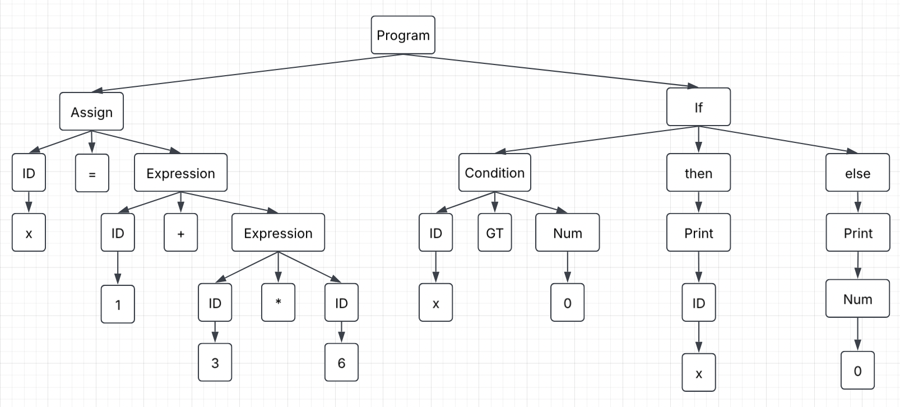
Abstract Syntax Tree Nodes
Construct an AST for program below:
x = 1 + 6 * 9
if x > 0:
print (x)
else:
print (0)

Slide 20
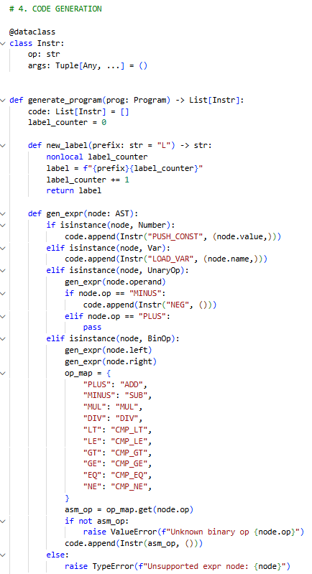
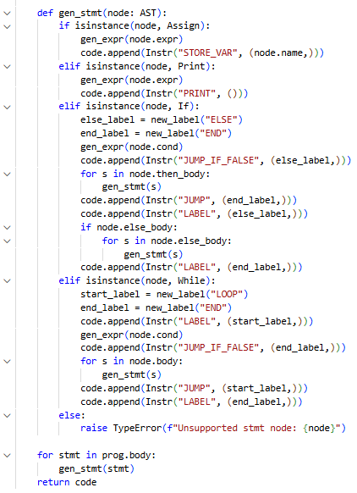
Code Generation
Generate assembly by traversing the AST inside generate_program(), emitting an Instr object for each step
Each instruction contains an opcode and some arguments, matching the exact structure used by our VM
Expressions compile into sequences of PUSH_CONST (numbers), LOAD_VAR (variables), and arithmetic or comparison instructions, executed from left to right
Nodes such as If and While are turned into LABEL, JUMP, and JUMP_IF_FALSE instructions
This code generation phase produces the final assembly program that our VM executes and that we later convert into x86 assembly.

Slide 21
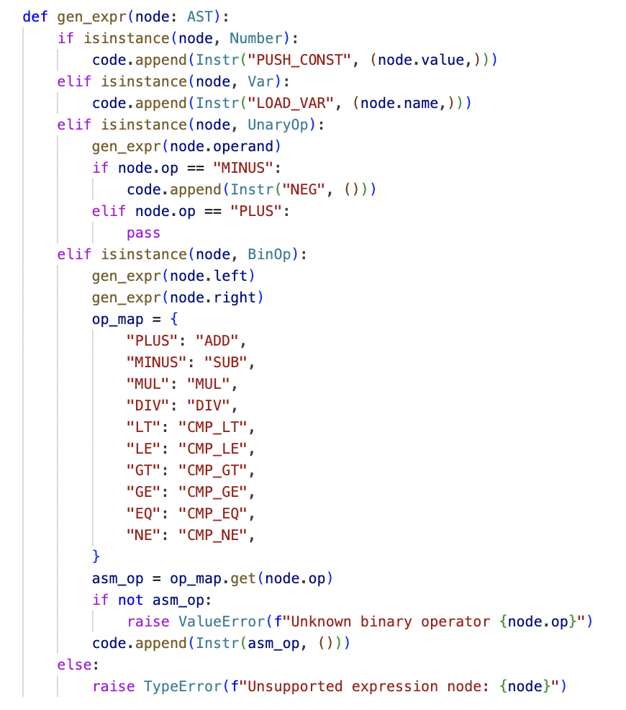
Expression Code Generation
For Number nodes, we generate PUSH_CONST <value>, placing the literal integer directly on the VM stack.
For Var nodes, generate LOAD_VAR <name> to load the current value of the variable from the runtime environment.
For UnaryOp nodes, first, we generate code for the operand and then apply NEG when the operator is MINUS, leaving the negated value on the stack.
For BinOp nodes, compile the left and right operands and then map the operator to an instruction such as ADD, SUB, MUL, DIV, or one of the CMP_ comparison instructions.

Slide 22
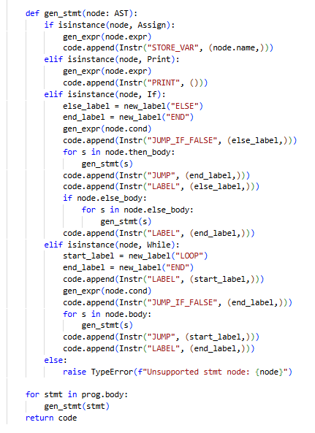
Statement Code Generation
For Assign nodes, compile the expression first and then emit STORE_VAR <name> so the computed value is written into the runtime environment.
For Print nodes, compile the expression and then emit PRINT, which makes the VM pop and display the value on the top of the stack
For If nodes, also compile the condition, emit JUMP_IF_FALSE to an ELSE label, compile the then_body, emit a JUMP to an END label, and then place LABEL instructions for both ELSE and END.
For While nodes, emit a LOOP label, compile the condition, emit JUMP_IF_FALSE to an END label, compile the loop body, and then emit a JUMP back to LOOP before placing the END label

Slide 23
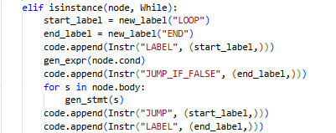
While Loop Code Generation
For While nodes, we generate a LOOP start label and immediately compile the loop condition after it.
JUMP_IF_FALSE is emitted to an END label so that the loop exits when the condition becomes false.
The loop body statements after the conditional check, allowing the VM to execute the body only when the condition is true.
We emit a JUMP back to the LOOP label to repeat the loop, forming the full control-flow cycle.
We finally emit the END label so execution continues after the loop once the condition is no longer satisfied.

Slide 24
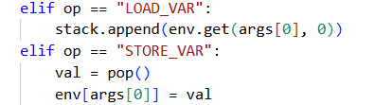
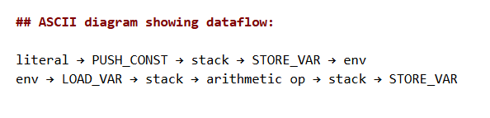
Dataflow Analysis and Memory Management
Our runtime environment env is a Python dictionary that maps variable names to their current integer values, representing the program state.
Assignments compute a value on the VM stack and then emit STORE_VAR <name>, which pops the top of the stack and updates env with the new binding.
Expressions that reference variables use LOAD_VAR <name> to push the stored value from env back onto the stack.
Together, the stack and env model the full dataflow of a Mini-Python program, showing how values move between literals, computations, variables, and control-flow operations.

Slide 25
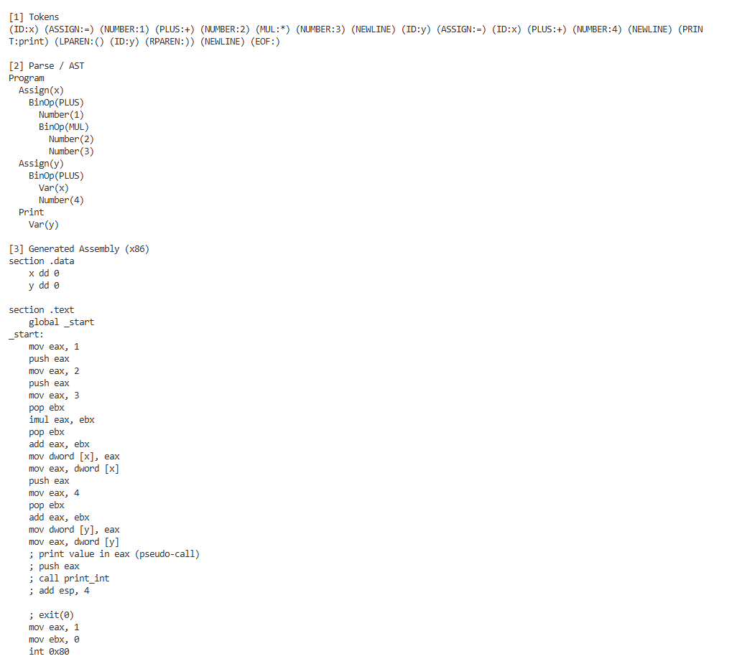
Demo 1 – Arithmetic and Print
Demo 1:
x = 1 + 2 * 3
y = x + 4
print(y)
The assembly includes PUSH_CONST, ADD, MUL, STORE_VAR, LOAD_VAR, and PRINT instructions that implement the arithmetic on our stack machine
The VM execution prints 11 and ends with env = { x: 7, y: 11 }, confirming that our compiler correctly follows operator precedence, ensures accurate in arithmetic.

Slide 26
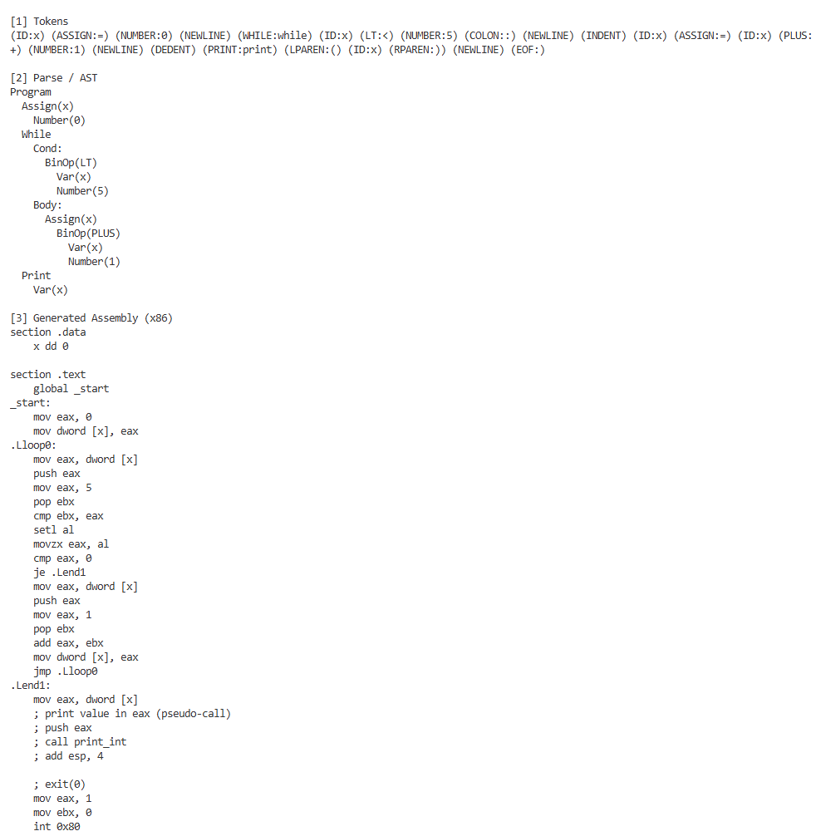
Demo 2 – While Loop
Demo 2:
x = 0
while x < 5:
x = x + 1
print(x)
The generated assembly introduces a LOOP label, compiles the condition using LOAD_VAR and CMP_LT, emits JUMP_IF_FALSE to an END label, compiles x = x + 1, and then emits a JUMP back to LOOP.
When executed on the VM, the loop runs until x reaches 5, printing 5.

Slide 27
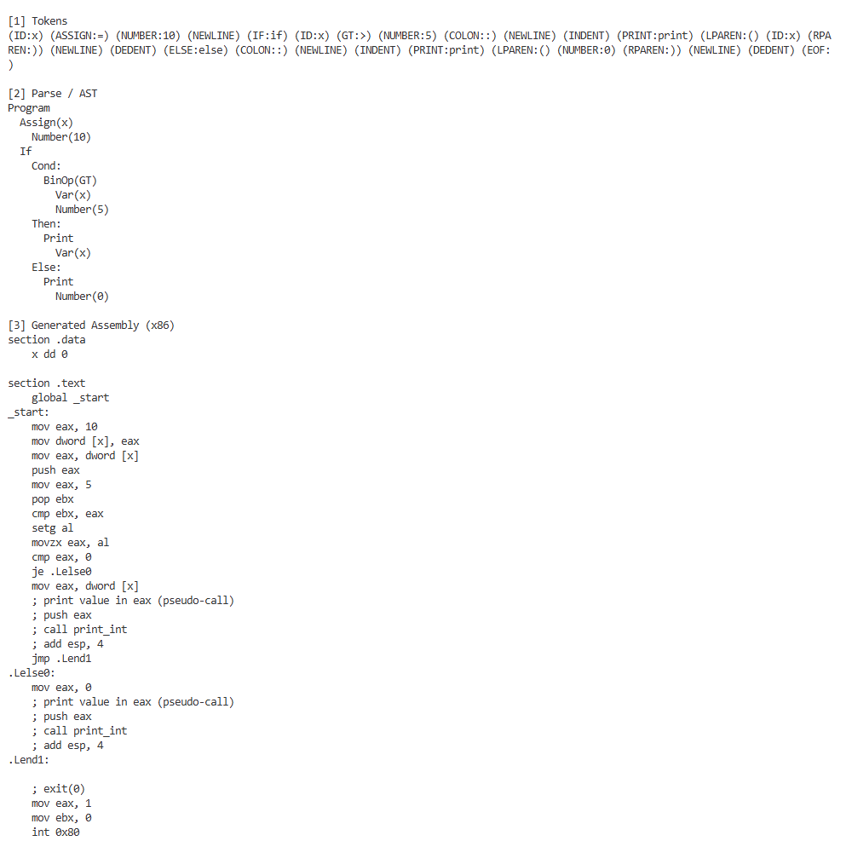
Demo 3 – If / Else Branching
Demo 3
x = 10
if x > 5:
print(x)
else:
print(0)
During VM execution, the condition x > 5 is true, so the then-body runs, and printing 10 showing the accurate of the generated assembly.

Slide 28
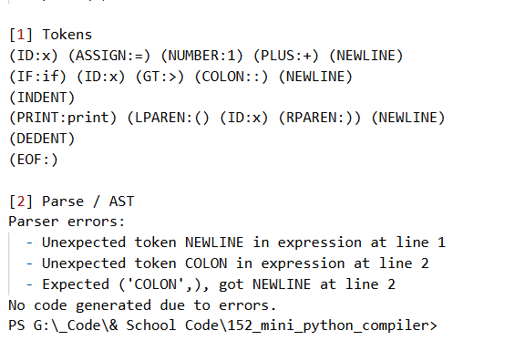
Error Demo – Syntax Errors
Error demo :
x = 1 +
if x > :
print(x)
When errors exist, compile_and_run() prints the collected messages, skips code generation entirely

Slide 29
Limitations and Scope
Limit to integers, simple arithmetic, variable assignment, printing, and basic control flow in order to keep the compiler small and focused.
This compiler does not support user-defined functions, for loops, return statements, boolean, or complex data types.
The code generation performs integer arithmetic only
Compiler may crash or generate wrong result due to no type checking
The compiler runs on our Python-based virtual machine as required by the project rubric. The x86 assembly we show is only a conceptual mapping, not actual machine-executable code.

Slide 30
Summary
In this project, we implemented a Mini Python compiler that translates raw source code to assembly code and finally executed on our custom virtual machine.
We integrated core theories such as regular expressions, tokenization, context-free grammars, and recursive descent parsing with precedence handing into this.
We demonstrated correctness using three demo programs covering arithmetic, loops, and branching, plus a syntax-error example that validates our error handling.
This project illustrates how formal language theory can guide the construction of real compilers while keeping the system small, coherent, and fully understandable.

Slide 31
References
Alfred Aho, Monica Lam, Ravi Sethi, and Jeffrey D. Ullman, Compilers – Principles, Techniques, and Tools, 2nd Edition, Pearson publication, 1986, ISBN no: 0-321-48681-1

Slide 32
THANK YOU

